Slide 1
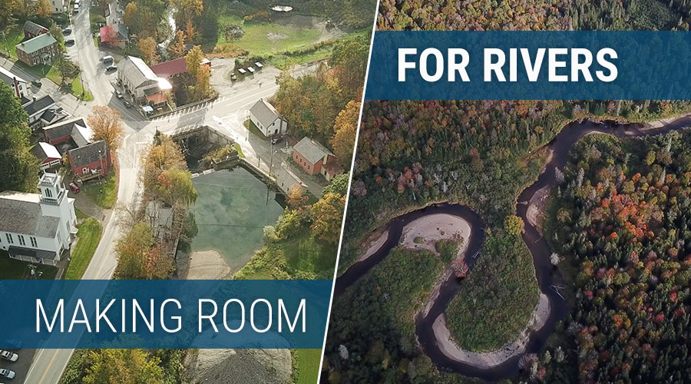
www.floodtraining.vt.gov

Slide 2
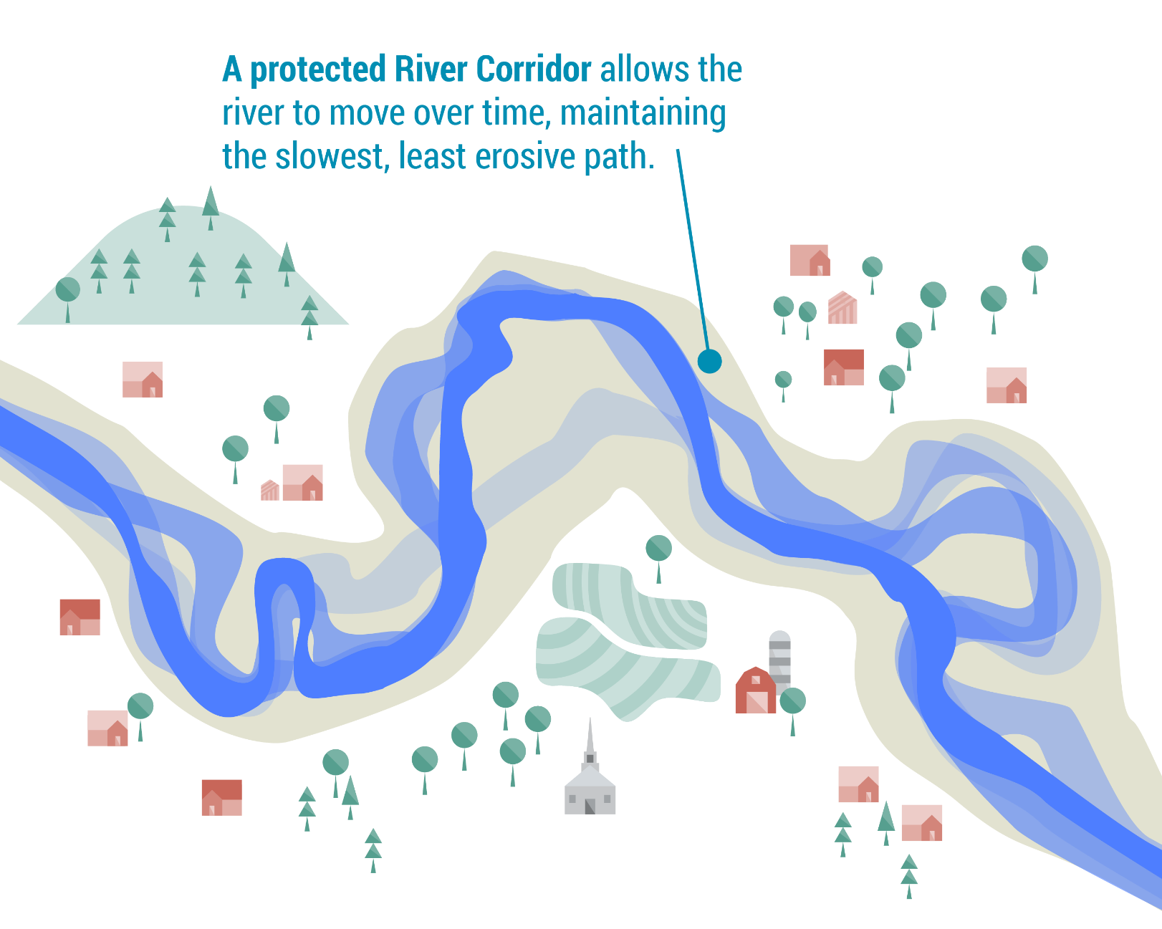

Slide 3
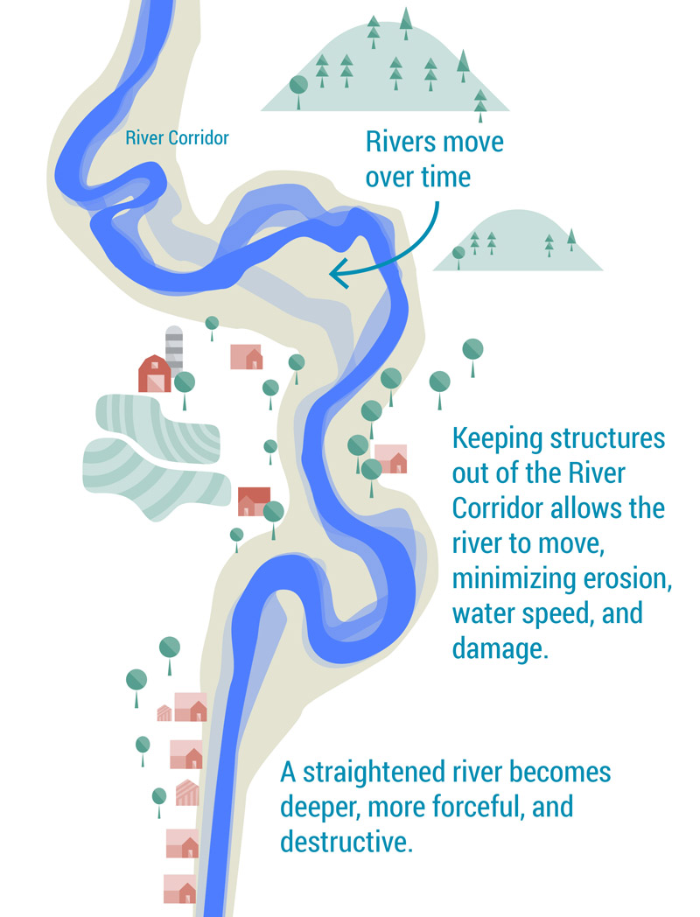

Slide 4
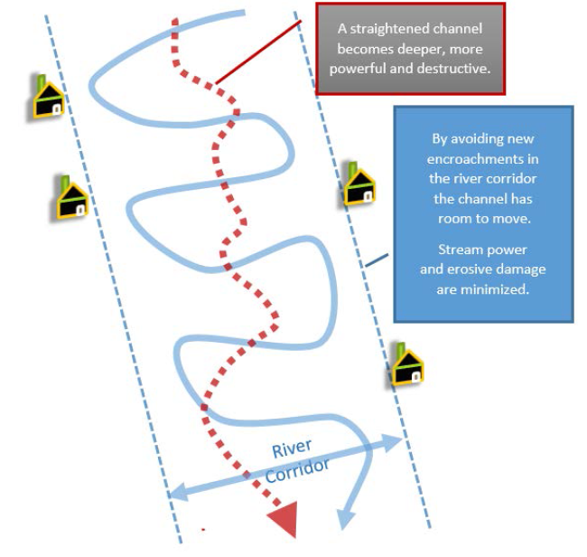

Slide 5
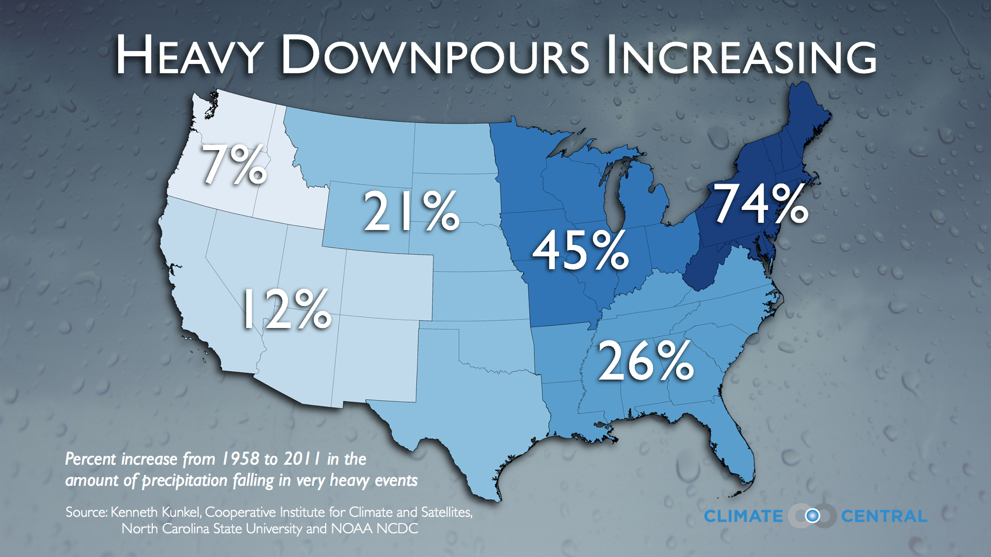
Why is the update needed now?

Slide 6
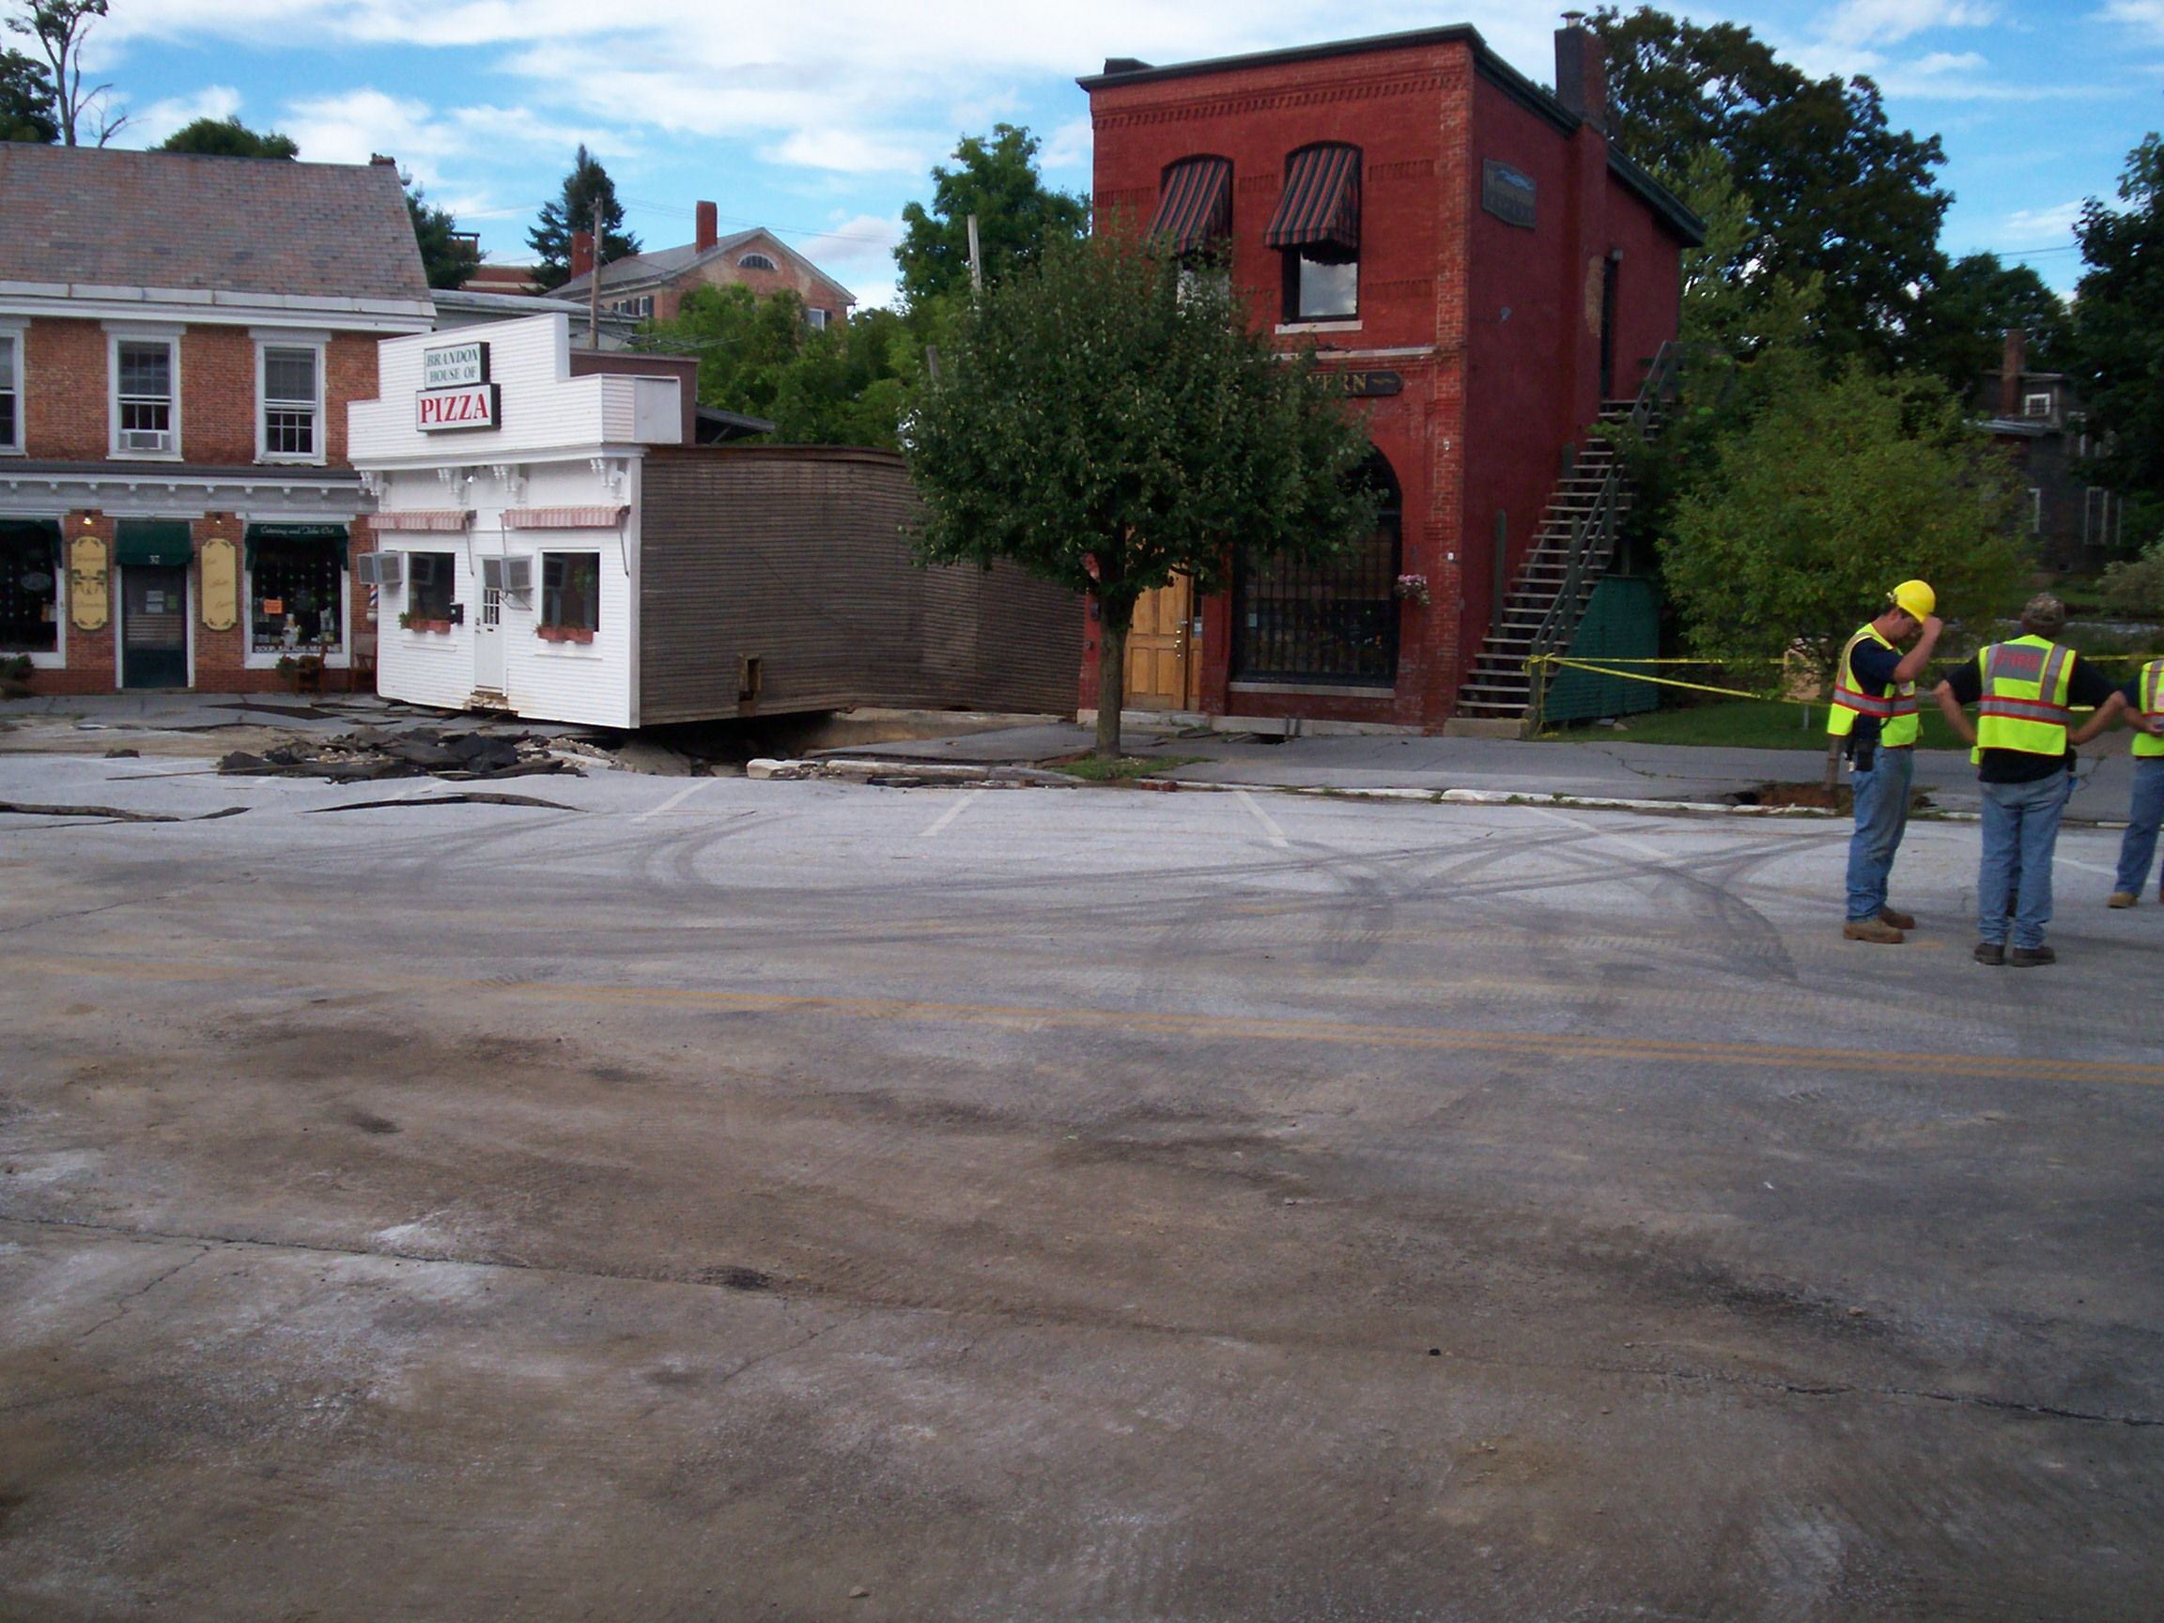
www.floodtraining.vt.gov

Slide 7
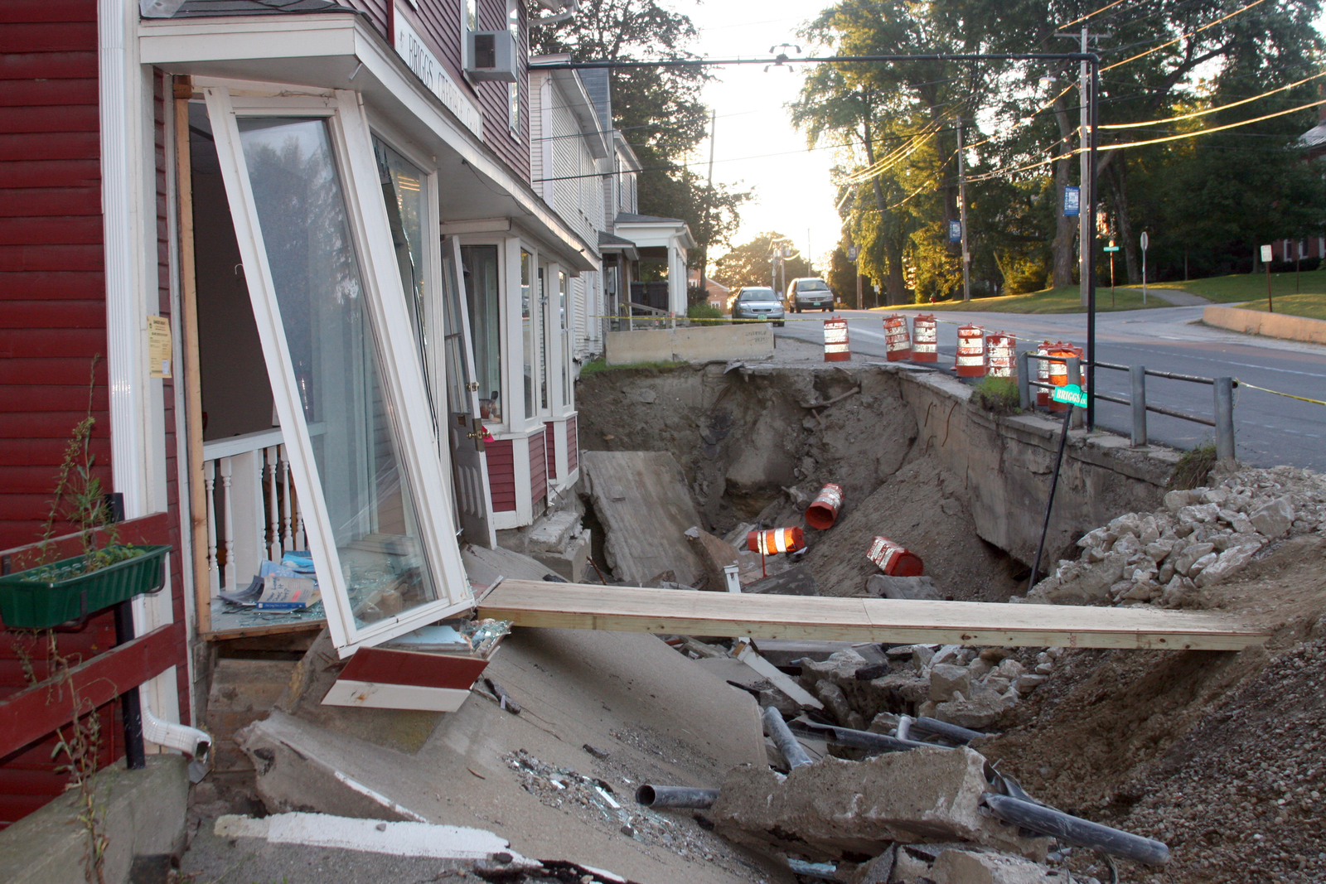
www.floodtraining.vt.gov

Slide 9
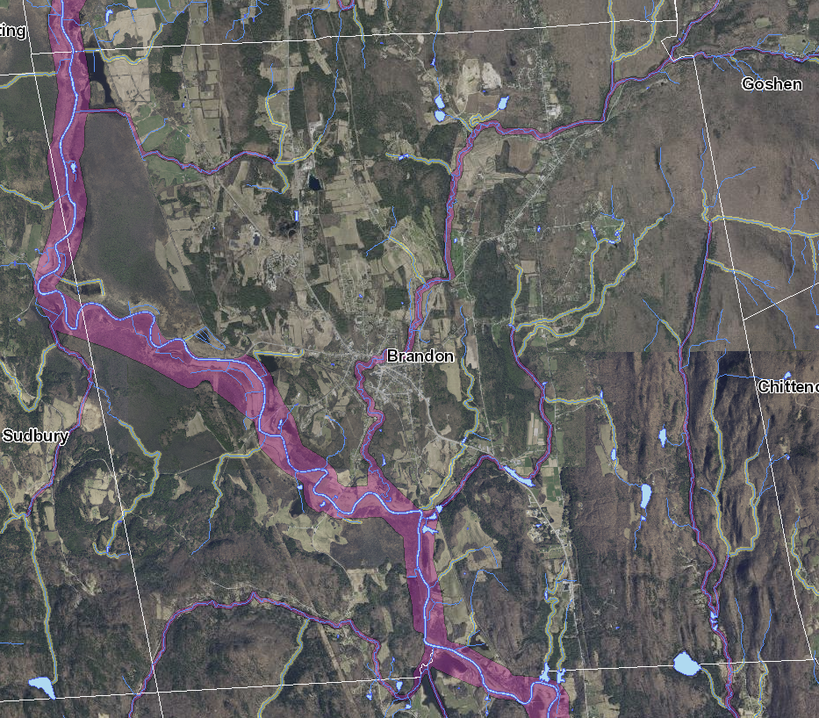
Notes:
Section 625. Riverbank Protection
(a) No development within 100 feet from the mean high water mark of named rivers and streams shall be permitted by the Administrative Officer, except for uses and structures that do not have the potential to threaten the stability of the stream bank, such as fencing, picnic tables, cooking grills, tents, recreational vehicles, and camping trailers, provided that such recreational equipment remain on the land less than six months of the year.
(b) Development that does not meet the test in Subsection (a) above will be reviewed under the standards for Fluvial Erosion Hazard Areas in Section 800.

Slide 10
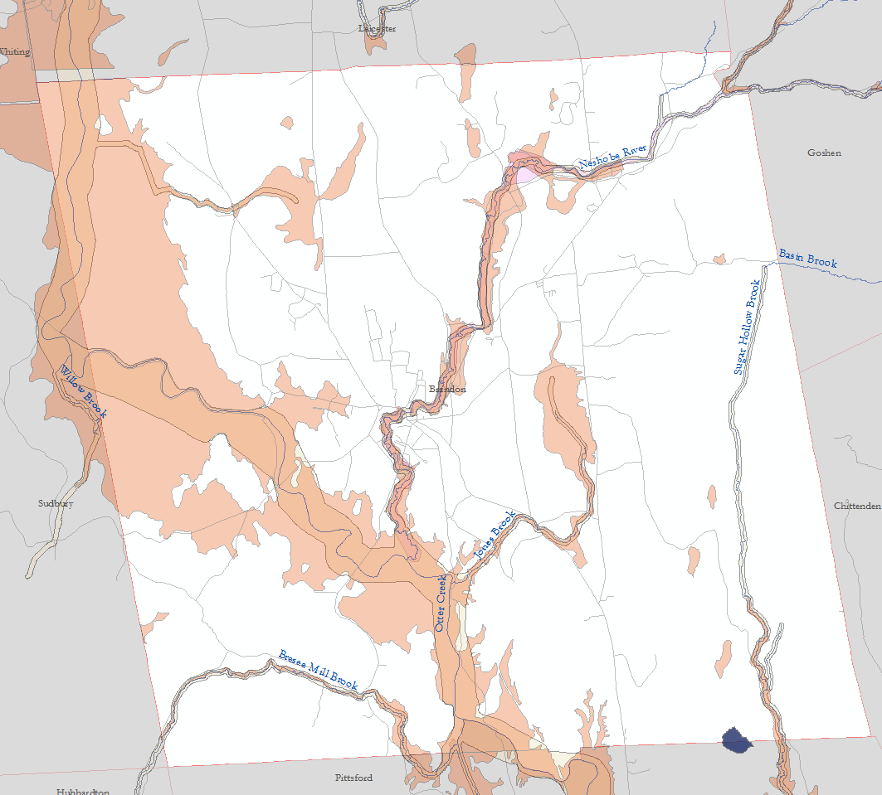

Slide 11
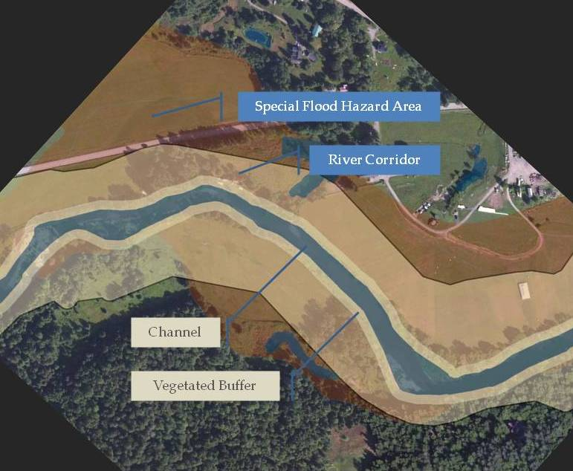
www.floodtraining.vt.gov

Slide 13
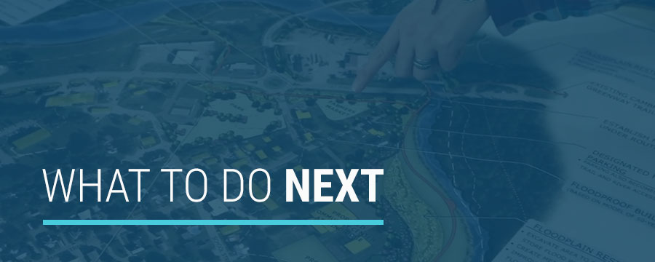
www.floodtraining.vt.gov

Slide 14
www.floodtraining.vt.gov
Protect Core Functions of Floodplains
  Flood water storage, flood water movement
  Agriculture, forestry, reliable water power
  Groundwater recharge
  Water quality protection (trap sediments)
  Soil development
  Wildlife and fish habitat
  Community recreation, beauty, inspiration

Slide 15
www.floodtraining.vt.gov

Slide 16
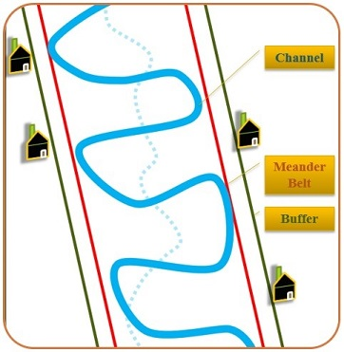

Slide 17
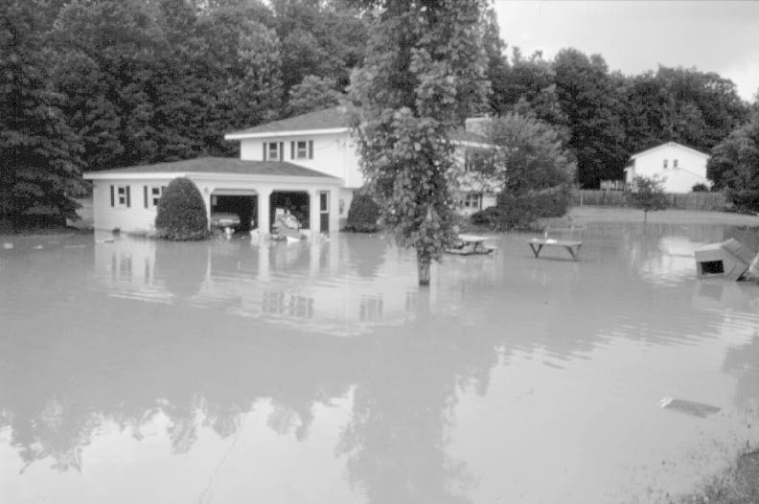
Base flood elevation
Notes:
17

Slide 18
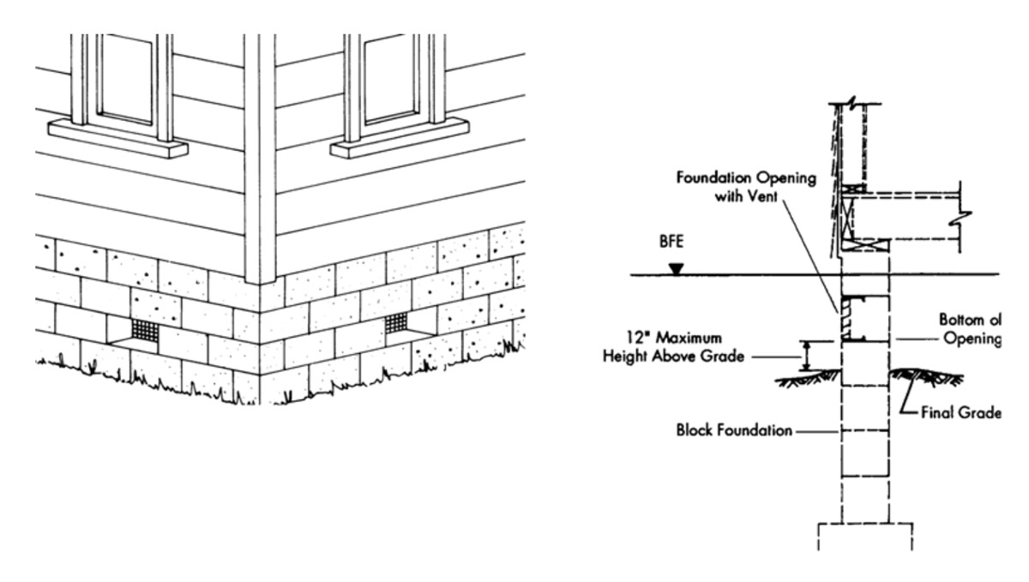

Slide 19
Elevate building utilities
Add openings in your foundation walls
(flood vents)

Slide 20
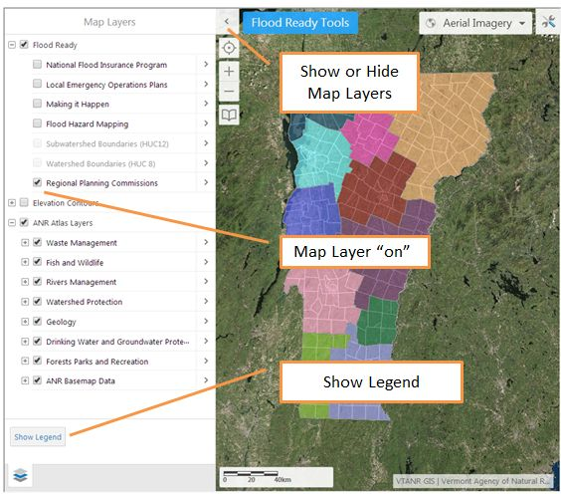

Slide 21
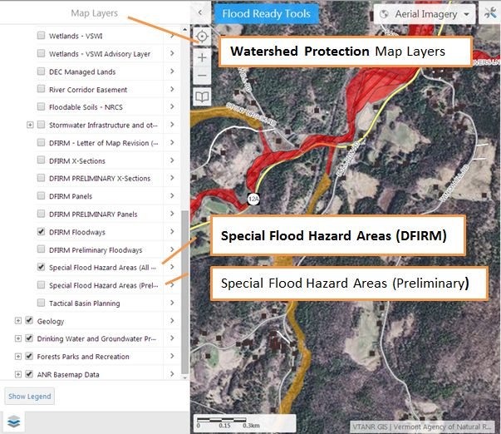

Slide 22
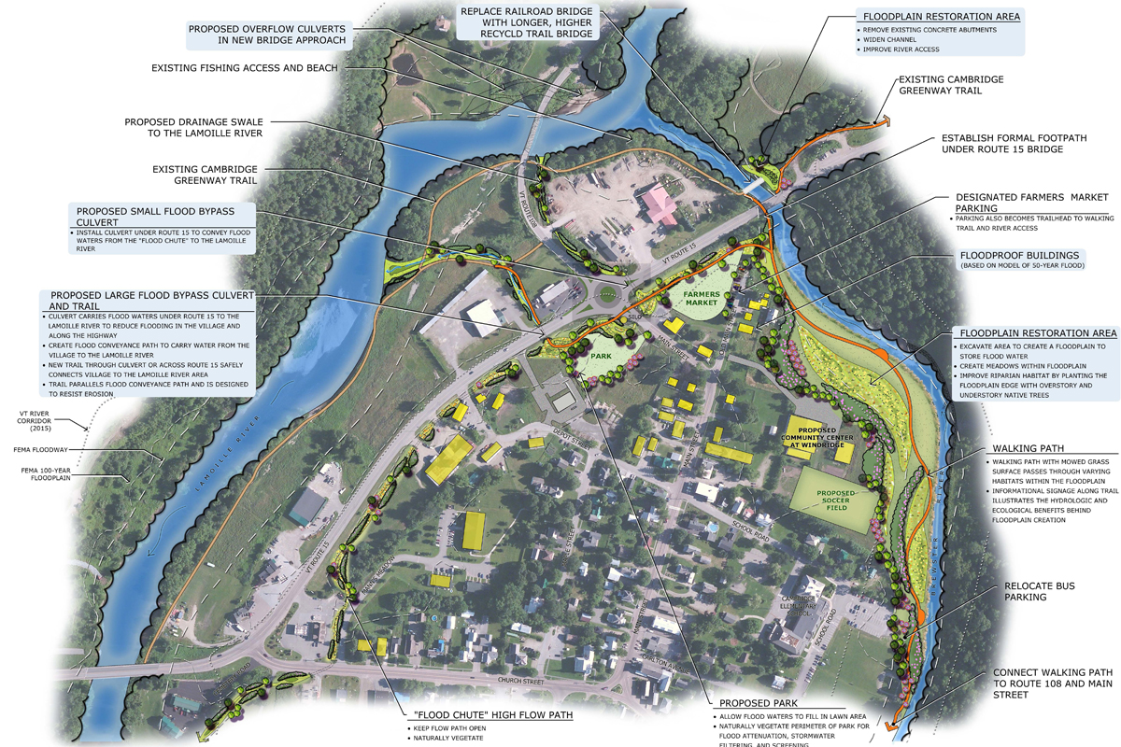
www.floodtraining.vt.gov

